Slide 1


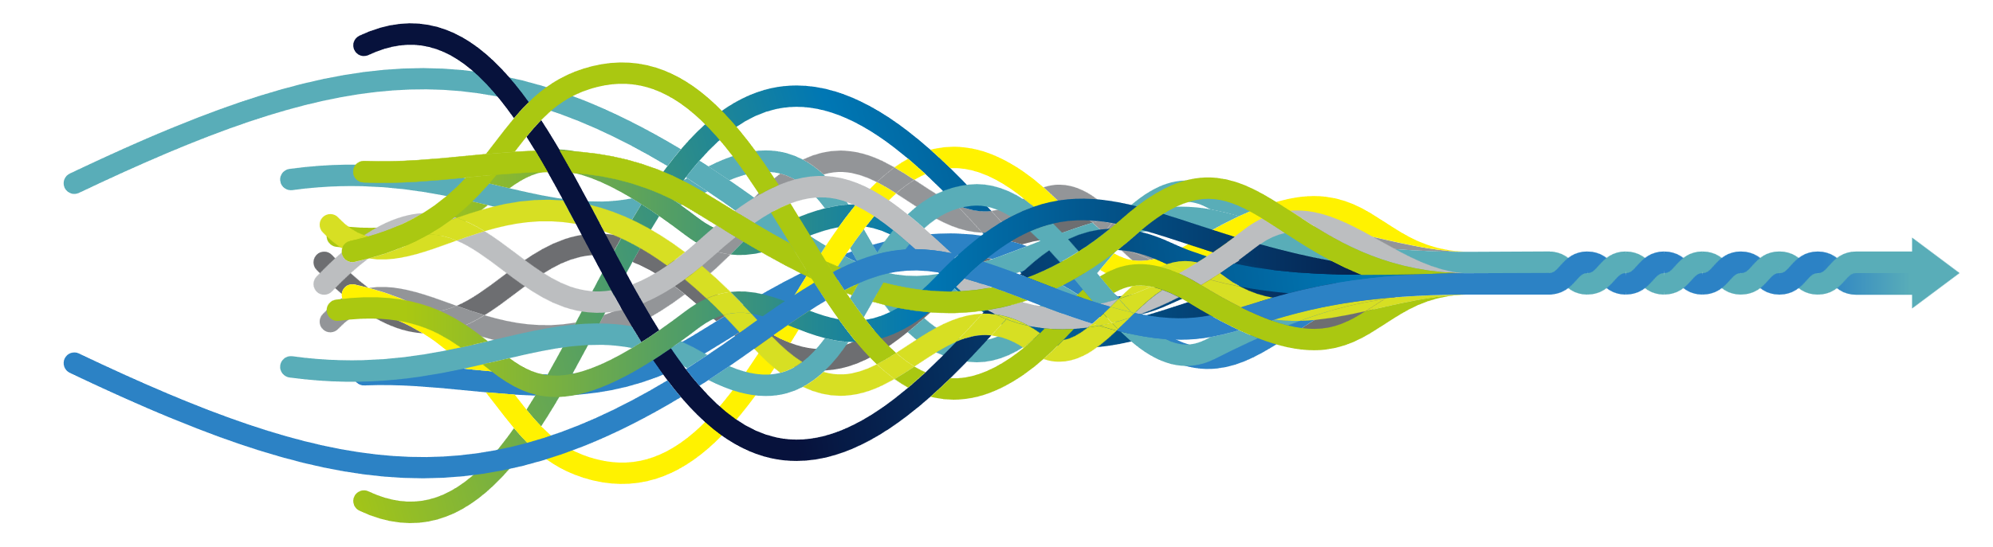
Digital and the 10 Year Health Plan: Making Wearables Work for People
Will Warburton
DIRECTOR OF LIFE SCIENCES POLICY & STRATEGY, NHS ENGLAND

Slide 2





Context: An NHS under pressure
The future of NHS finances is unsustainable
UK health spend is ~11% of GDP and accounts for 38% of public expenditure. In cash terms this equates to £188.5bn (2023/24). Of this, £81.7bn is spent on staff – excluding GPs (38% is projected to rise to 40% by 2035)
Workforce issues are equally acute
NHS FTE staff has increased by ~30% since 2009. Staff sickness rate is at 5.6% and 1 in 10 left the NHS in 2024.
Public satisfaction is low
59% of people were dissatisfied with the NHS in 2024. Time to access appointments or care is the leading reason for dissatisfaction.
Widening Health Inequalities
Healthy life expectancy is 18+ years lower for the most deprived. People in the most deprived areas are 2x as likely to wait over a year for elective procedures.
To continue to provide healthcare free at the point of need, we must find new approaches
Notes:
To note some data is time lagged but generally looking at 2023-25
What Is Happening To Life Expectancy In England? | The King's Fund
Deaths registered in England and Wales - Office for National Statistics
NHS Workforce Nutshell | The King's Fund
NHS England » NHS productivity
The NHS Budget And How It Has Changed | The King's Fund
NHS England » Staff leaving the NHS among lowest in over a decade
All is not well: Sickness absence in the NHS in England | Nuffield Trust
Public Satisfaction With The NHS And Social Care In 2024 | BSA | The King's Fund

Slide 3
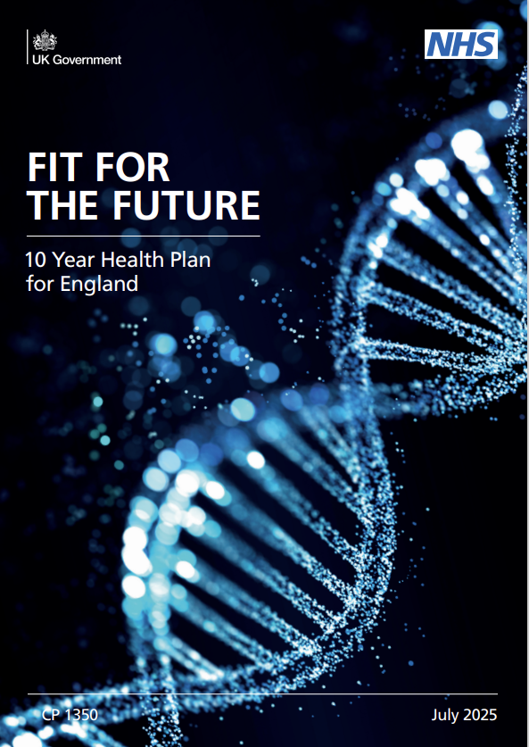
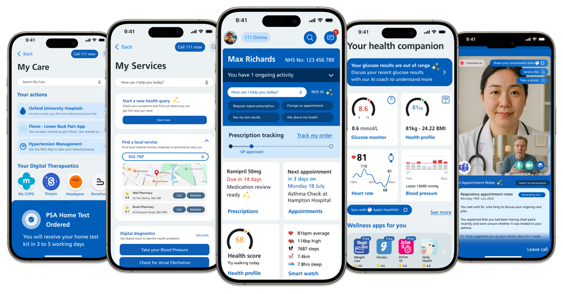
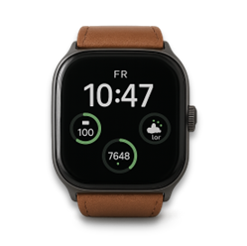
The 10 Year Health Plan: Wearable & Smartphone Ambitions
'Make remote monitoring for cardiovascular disease, using wearables and similar devices integrated into the NHS App, a standard part of NHS care by 2028'
'Make wearables standard in preventative, chronic and post-acute NHS treatment by 2035'
'Wearables bring the insights from data, AI, and genomics directly to the patient or clinician, enabling continuous monitoring, pre-emptive interventions, and more personal care delivery'
The NHS App has an ambitious vision to go beyond being “the NHS front door” and become a healthcare companion.
At the core of new home-based pathways will be health and wellness services, spanning digital diagnostics, home blood testing, digital therapeutics, bio-marker monitoring, 3rd party-Apps and AI coaches....
All made possible by a Personal Health Record​​

Slide 4
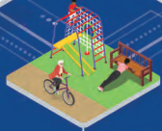
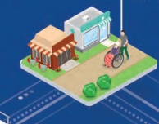
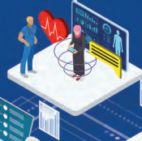
The Three Big Shifts
Sickness to Prevention
Early warning signals
Risk detection at scale
Behavioural nudges
Hospital to Community
Remote monitoring & management
Care at home and in neighbourhood settings
Lower burden
Analogue to Digital
Automated data capture
Real time health insights
Personalised digital guidance

Slide 5
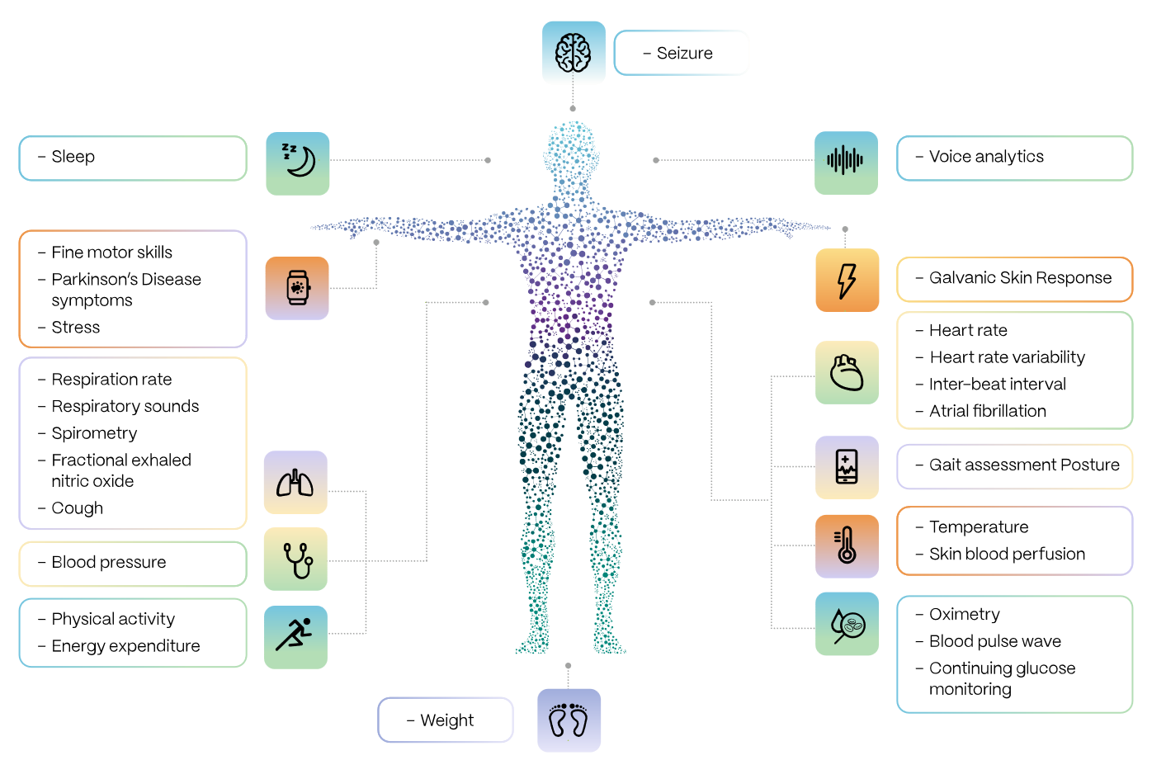
What can we measure

Slide 6







The “wearables” value chain (An NHS perspective)
The logic model below provides a high-level summary of the flow of value from devices, all the way through to the NHS’ ultimate objective of improving healthcare outcomes.
Device | Data | Visualisation & understanding | Insight & education | Action planning & tracking | Individual impact & reward | Health, NHS productivity & economic outcomes

Slide 7
What challenges might we need to address to unlock value?
Proprietary Smartphone Visualisations
Pathway transformation
Accuracy
Proprietary Algorithms
Source & Device Metadata
Misleading information
HCP support required to build/maintain plan?
Built-in vs assuring 3P behavioral science
Who will evaluate the clinical and economic outcomes?
Device Usability
Funding incentive schemes
Mismatch between product and NHS use case
Mobile Health Data Aggregator APIs
Siloed data
Device | Data | Visualisation & understanding | Insight & education | Action planning & tracking | Individual impact & reward | Health, NHS productivity & economic outcomes
Device regulation
Defining & categorising devices
Clinical system switching
Public and Clinical trust
Making information contextual
Build/buy/ integrate AI Coach
Cost & Access
Direct integrations
How are benefits sustained over time?
Do wearables make a demonstrable, material, marginal difference?
Health Inequalities
AI Coach regulation
NHS Visualisations vs 3P – why NHS?

Slide 8
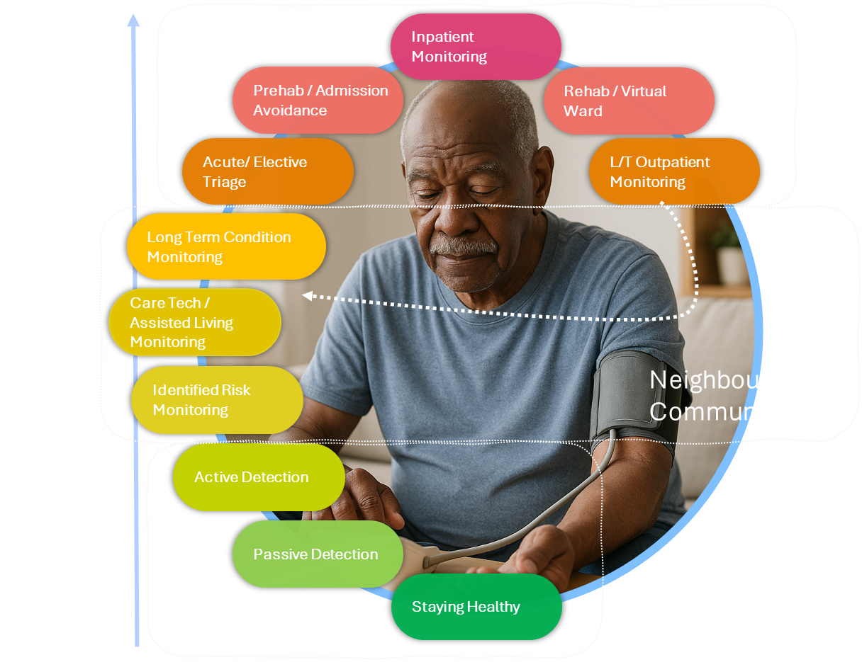
Unlocking better outcomes together
Wearables can support people across every stage of care, from staying healthy to managing high‑acuity conditions
The opportunity spans prevention, community care, and acute pathways, a whole‑system impact.
Success relies on collaboration across patients and public, clinicians, industry, academic, NHS teams and many more
The goal: earlier detection, smarter monitoring, and better outcomes for millions

Slide 9



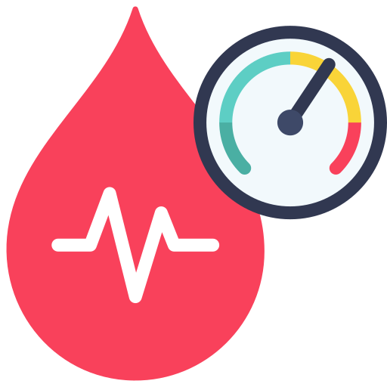
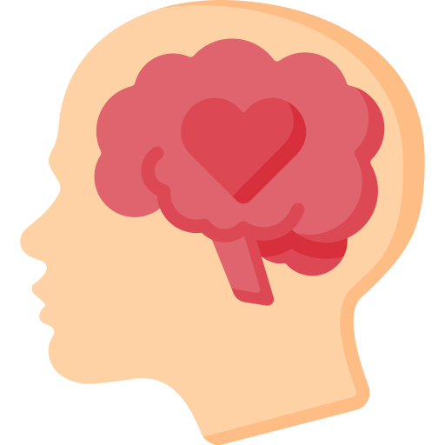
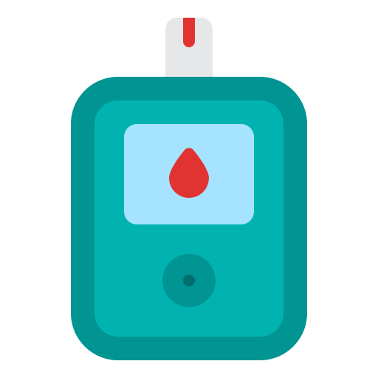

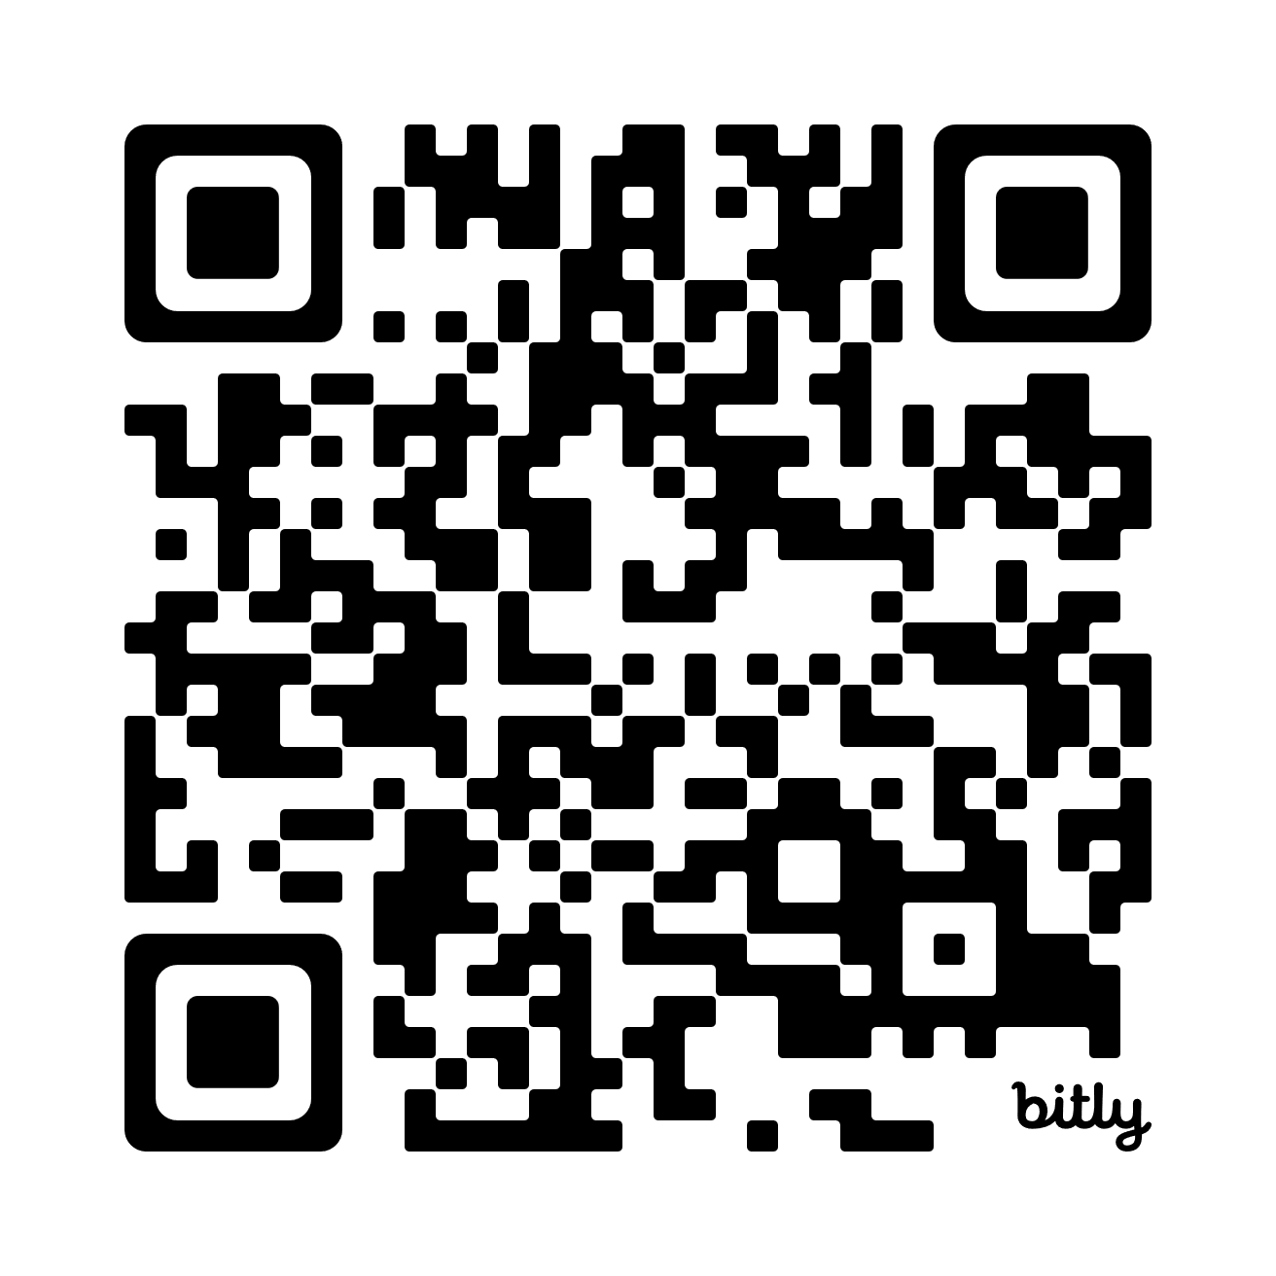
A call to action - complete our survey
Wearables and connected devices in CVD pathways
The Department of Health and Social Care and NHS England are collaborating with the British Heart Foundation to understand:
the extent to which wearables and connected devices are already in use in cardiovascular clinical services
the purposes for which they are used
barriers and enablers to national adoption
Open to February 20th
Your insights will help shape future national policy

